Slide 1
UPDATING 360 FEEDBACK & LOCATE STATUSES
A HOW TO GUIDE

Slide 2
LOCATE TIMELINES OVERVIEW STANDARD LOCATE REQUEST
5
Business Days
3
Business Days
Members are required to complete a locate within 5 business days of receiving a standard locate notification.
S.6 (3) of the Act
Members need to provide an update to 360 Feedback within 3 business days of completing a locate.
S.14 (1) of the Act

Slide 3
LOCATE TIMELINES OVERVIEW DEDICATED LOCATE REQUEST
10
Business Days
3
Business Days
The Dedicated Locator is required to complete a locate within 10 business days of receiving the Dedicated locate notification.
S.7 (10) of the Act
Member or Dedicated Locator shall notify Ontario One Call within 3 business days of completing a locate.
S.14 (1) of the Act

Slide 4
LOCATE TIMELINES OVERVIEW EMERGENCY LOCATE REQUEST
2
Hours
3
Business Days
Members are required to have a person onsite, or provide a clearance within 2 hours.
S. 6 (4) of the Act
Members need to provide an update to 360 Feedback within 3 business days of completing a locate.
S.14 (1) of the Act

Slide 5
360 FEEDBACK DEFINED
“360 Feedback” means the web-based solution provided by Ontario One Call for either:
Members or Members’ designates to use to notify Ontario One Call whenever the status of a Locate Request has changed or
anyone that has requested a locate to use the online function and check the status of their request or find contact information for each member notified.

Slide 6
BENEFITS OF UPDATING 360 FEEDBACK?
Besides being a legal obligation for Members to update 360 Feedback, the information provided is also valuable to Excavators, Ontario One Call and other Members.
Major Benefits:
de-escalate suspected late locate situations
reduce reach outs and follow up calls
validate the renegotiation of a new due date
notify Ontario One Call of a Locate Delay
track locator performance, whether it be internal staff or an external locating company completing locates

Slide 7
360 FEEDBACK OBLIGATIONS SECTION 14(1) of the Act
3
Business
days
Upon completing a locate a Member (or their LSP) must update 360 Feedback within three (3) Business Days.

Slide 8
STATUS OPTIONS
360 FEEDBACK

Slide 9
360 FEEDBACK STATUS OVERVIEW
Temporary Status
These statuses do not stop or change the response time required for the Member to complete a locate request
Not Completed
Notification Sent
Requestor Must Provide More Info
Sent to Locator
Contact member
Temporary Status
Changes the legal due date. Response required by the new renegotiated date.
Renegotiated
Complete Status
Only way to legally complete a locate request in 360 Feedback.
Cleared
Completed

Slide 10
360 FEEDBACK STATUSES
Notification Sent
Sent to Locator
This is the default status that is assigned to a locate by Ontario One Call to identify the locate was sent to the Member/LSP. This status cannot be re-assigned |  | If locates are screened for possible clearances before going to an LSP, this status should be the first status assigned if a physical locate is needed.
***Completed and Cleared are the only compliant statuses***

Slide 11
360 FEEDBACK STATUSES
Not Completed
Requestor Must Provide More Info
Contact member
Can be used for many reasons e.g. Locator has started, but not completed locate | The locate request could be too vague or may require clarification | The Member would like the Excavator to contact them
***Completed and Cleared are the only compliant statuses***

Slide 12
360 FEEDBACK STATUSES
Renegotiated
Cleared
Completed
An alternate locate due date was mutually agreed in writing by both Member/LSP and Excavator. For More info: Click Here | The excavation will not affect the infrastructure. Paperwork has been provided to the Excavator | The infrastructure has been marked and paperwork has been provided to the Excavator
***Completed and Cleared are the only compliant statuses***

Slide 13
UPDATING THE LOCATE STATUS
STEP BY STEP

Slide 14
LOGGING IN TO THE WEB PORTAL
On the landing page of the Web Portal log in as a Member
(reach out to MemberServices@OntarioOneCall.ca if you do not have access)

Slide 15
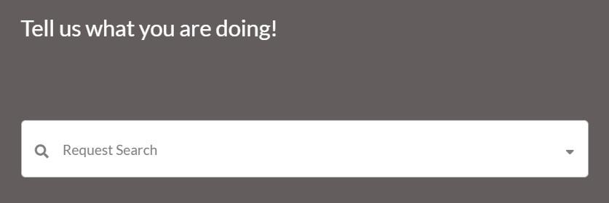
SEARCHING FOR REQUESTS
Click on the Request Search field
Use the basic search to search using the locate request number of the locate that requires a status update
Use the Advanced Search to search with different parameters such as date, location, type of request, station code, etc.

Slide 16
EXPANDED SEARCH RESULTS VIEW
When using the Advanced Search feature, the results may be displayed in an expanded list or a collapsed list.
The image below is the Expanded list which can be sorted using various criteria.
Select the request number in green to open the locate or click “Collapsed List” to change your view
Data can be exported monthly from the web portal. You can find the how-to guide here

Slide 17
COLLAPSED SEARCH RESULTS VIEW
This is what the Collapsed Search list looks like
Scroll through the list on the left and click on the locate you’d like to update
You can return to the expanded list by clicking “Expand List”

Slide 18
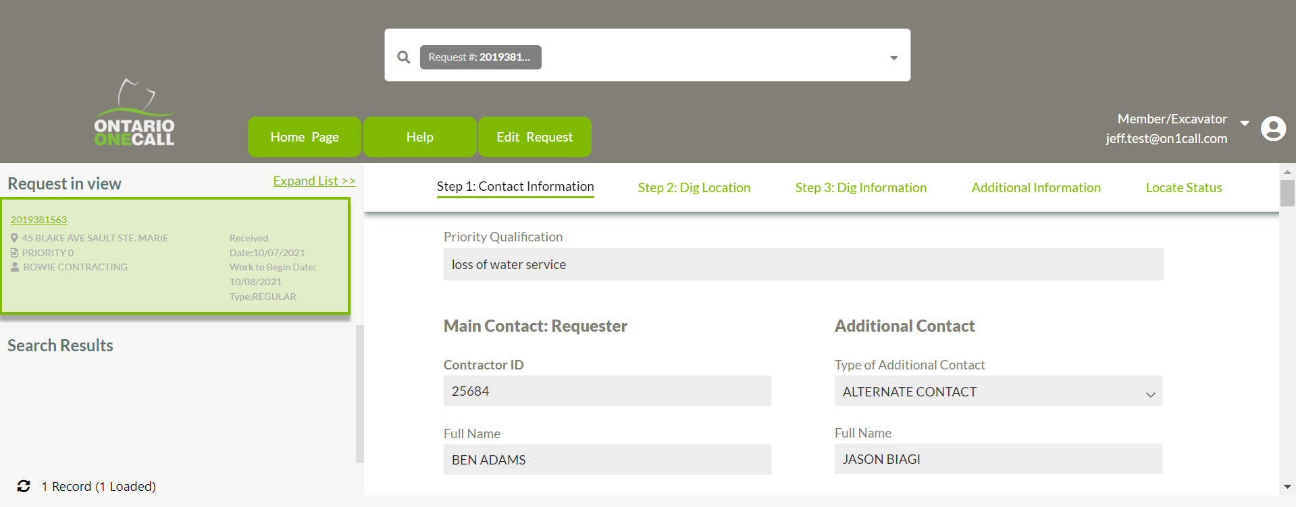
SEARCH RESULTS
The locate details are found to the right of the list. Scroll down to view all of the details
Click on “Locate Status” to skip to the status section or scroll down

Slide 19
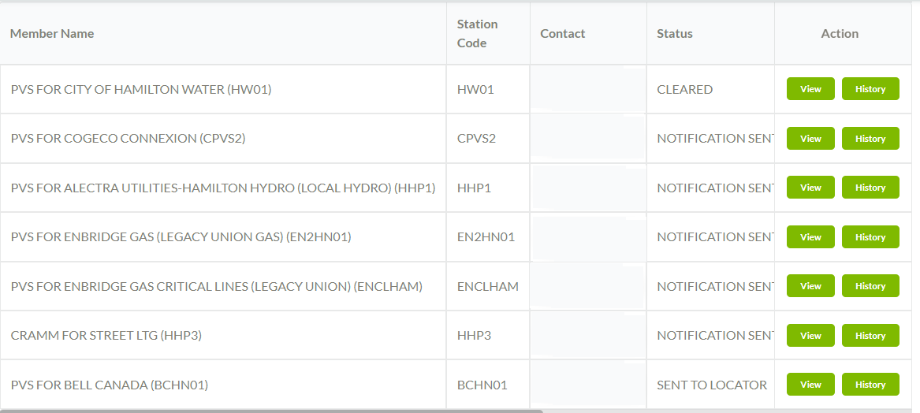
NOTIFICATION LIST
This is the list of infrastructure owners has been notified and their current statuses
The default status is “Notification Sent”
The notifications you are responsible for updating will show a “view” option. There could be more than one depending on your set up
*A renegotiation must be mutually agreed upon by the Infrastructure Owners/LSP and Excavator

Slide 20
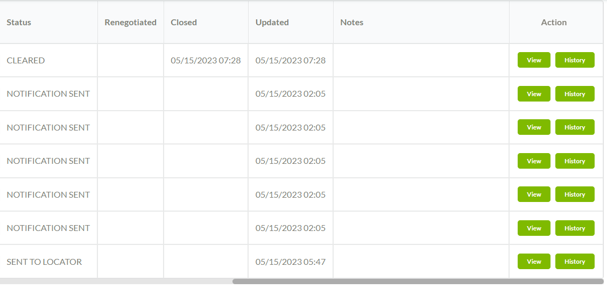
NOTIFICATION LIST
Use the horizontal scroll bar at the bottom to view the contact information and any notes for all members
*A renegotiation must be mutually agreed upon by the Infrastructure Owner/LSP and Excavator

Slide 21
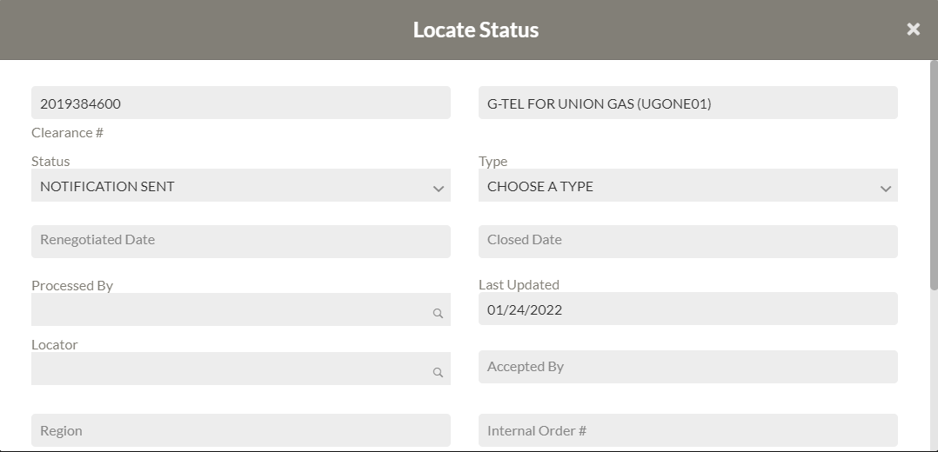
VIEWING THE LOCATE STATUS BOX
Clicking on “View” opens the Locate Status window in a view only state. No edits are possible

Slide 22
LOCATE STATUS - EDIT
To update the status of a locate, click on “Edit Request” near the top of the screen
A box will populate asking you to choose the action to perform on the locate in question. Click “Locate Status Modification”
The “View” option is now “Edit”. Click on “Edit’

Slide 23
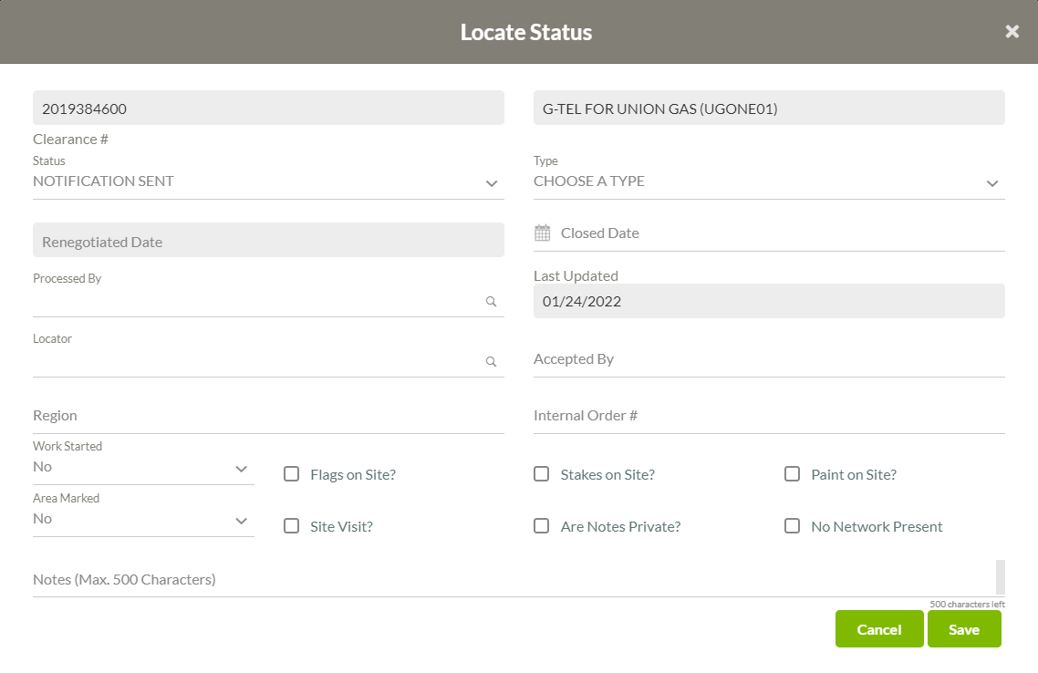
LOCATE STATUS - EDIT
Notification Sent is the original status assigned to a locate
There are 2 mandatory fields needed for every update – the status and processed by field
The other mandatory fields vary based on the status that is being assigned
If a mandatory field is not filled out, the system will provide you with feedback on which fields are mandatory when trying to save. The following chart provides a detailed outline of all relevant status information

Slide 24
STATUS OVERVIEW
Status | Use | Mandatory Fields
 |  | Closed Date | Processed By | Renegotiated Date | Notes
Completed | Locate area was physically marked | X | X
Marked/Completed | Use “Completed” | X | X
Cleared | The excavation will not affect the infrastructure and paperwork has been provided to the excavator | X | X
Not Completed | Temporary status used when a locate has not been completed |  | X |  | X
Contact Member | Something is preventing the completion of the locate i.e. broken tracer wire, site access needed, etc. |  | X
Renegotiated | The excavator and LSP mutually agreed to an alternate locate due date in writing | X | X | X | X
Requestor Must Provide More Info | More information is needed in order to provide a locate response. |  | X |  | X
Not Completed/Needs Additional Info | Select the stand alone status “Not Completed” or “Requestor Must Provide More info” |  | X
TIP – The statuses highlighted in yellow are older 360 Feedback responses. Statuses were updated in 2017 to provide more clarity. The previous statuses remain in the system as they are still used by Members with older software. Please select the newer statuses

Slide 25
IMPORTANT CONSIDERATIONS ABOUT STATUS
COMPLETED and CLEARED are the ONLY compliant statuses
If a locate is no longer required (e.g. the excavator has reached out saying it is no longer needed AFTER the work to begin date), please mark the request as 'Completed' with a closed date and add a note explaining the situation.

Slide 26
LOCATE STATUS - EDIT
The fields that most commonly require updating include:
Status
Processed by
Closed date
Notes
Feel free to use the other fields that are available as you see fit

Slide 27
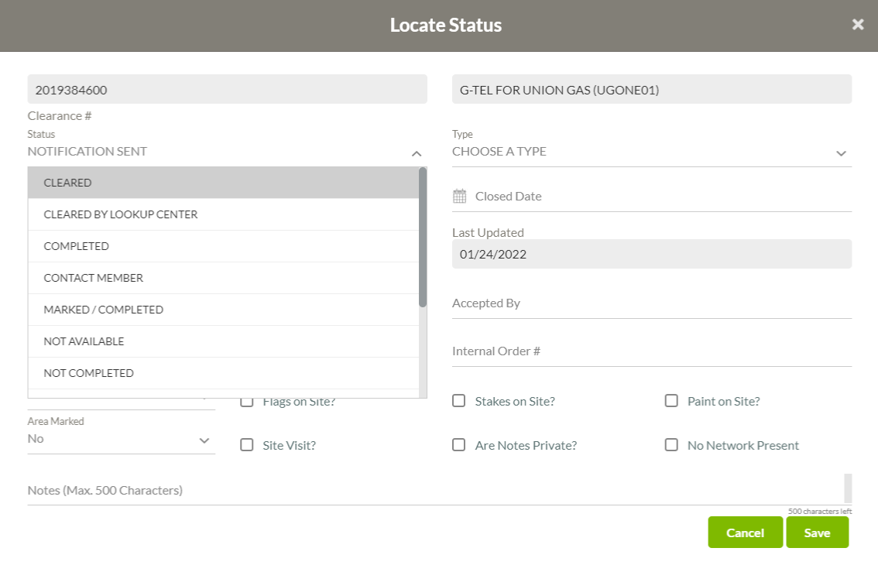
ASSIGNING A STATUS
Click on the Status field to open the drop down menu
Use the scroll bar on the left of the status drop down to select the accurate status
For an official locate response, the Request status MUST be updated and CLOSED

Slide 28
ASSIGNING A STATUS
You have not met your legal obligation if you have selected the following statuses:
Contact Member
Needs Additional Info
Requestor Must Provide More Info
Not Completed
Enter your name in the Processed by field
Use the Notes to explain why the status has been assigned
Click Save
For an official locate response, the Request status MUST be updated and CLOSED

Slide 29
ASSIGNING A COMPLIANT STATUS & CLOSING A LOCATE
Status: Select the accurate status
Was the locate cleared onsite?
Select Cleared
Was the infrastructure marked?
Select Completed
Closed Date: This is the date the paperwork is provided to the Excavator
Processed By: Add the name of whomever is updating the status
For an official locate response, the Request status MUST be updated and CLOSED

Slide 30
FINALIZING A LOCATE
Here’s an example of what a nearly finalized Completed status update looks like
Remember, a closed date is required when a cleared or completed status is assigned
After all of the required fields are filled out click Save
Each Member is solely responsible for the accuracy and adequacy of their locates, and any information provided to Ontario One Call

Slide 31
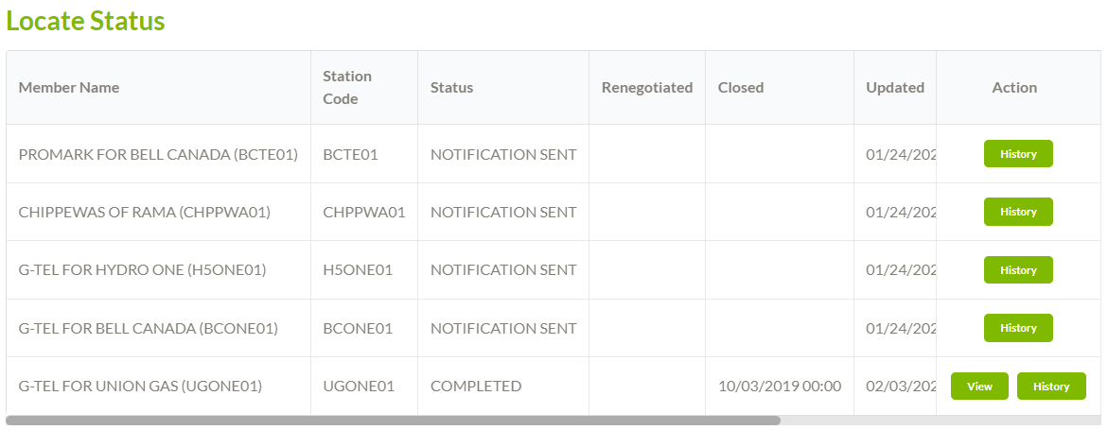
FINALIZED LOCATE

Slide 32
MANDATORY FIELDS
HOW TO USE

Slide 33
CLOSED DATE
Completed
Cleared
CLOSED DATE
An accurate Closed Date is mandatory when finalizing a locate. The closed date should be the date the paperwork was provided to the excavator.
Failing to include a Closed Date means the locate stays open and the clock keeps counting the days it takes to finalize the locate.
If there's no closed date by the intended timeline, it will be considered “non-compliant no response” even if the locate or clearance has been provided to the requestor.

Slide 34
NOTES
The Notes field should be used to document any communication with the Requestor or anything abnormal about the locate.
Examples:
Renegotiated: new due date of June 14th approved in writing to change legal due date on June 1st by Dwayne Roberts, project lead
Requestor Must Provide More Information: 06/01/2021 L/M for Steve requesting site plans to clarify dig location
Not Completed: 06/01/2021 Broken tracer wire. Will be onsite to rectify on June 8th
*Remember, none of these statuses are compliant. Further action must be taken to fulfill your locate obligations.
NOTES
Renegotiated
Requestor Must Provide More Information
Not Completed
Notes:
The Notes field should be used to document anything abnormal about the locate.

Slide 35
AUTOMATING 360 FEEDBACK RESPONSES
WHAT YOU NEED TO KNOW

Slide 36
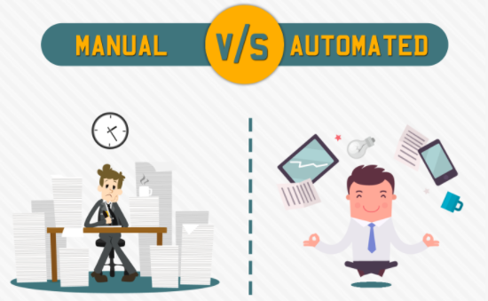
AUTOMATED SOFTWARE
Options are available to automate your responses to 360 Feedback. It becomes advantageous when receiving 4 or more locates per day on average
Source: www.qualitesoft.com

Slide 37
SOFTWARE
Program your existing work management system, using our Web Service document, to respond directly to 360 Feedback
Purchase software that will automatically update 360 Feedback, while also providing many other benefits to streamline your locate processes
There are two options available to automate the 360 Feedback responses
Please note: should the Member decide to purchase software, they are responsible to make sure it correctly integrates with 360 Feedback

Slide 38
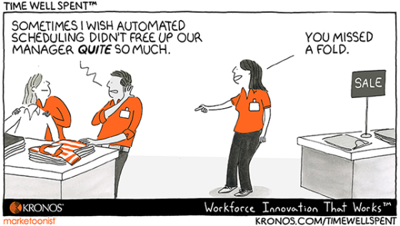
AUTOMATED SOFTWARE
Contact our Education & Training team to request the Web Service document or for a list of available Software Providers
Training@OntarioOneCall.ca

