Slide 1
GroundWork awarding the Professional Locate Administrator Certificate
Creating Your Account

Slide 2
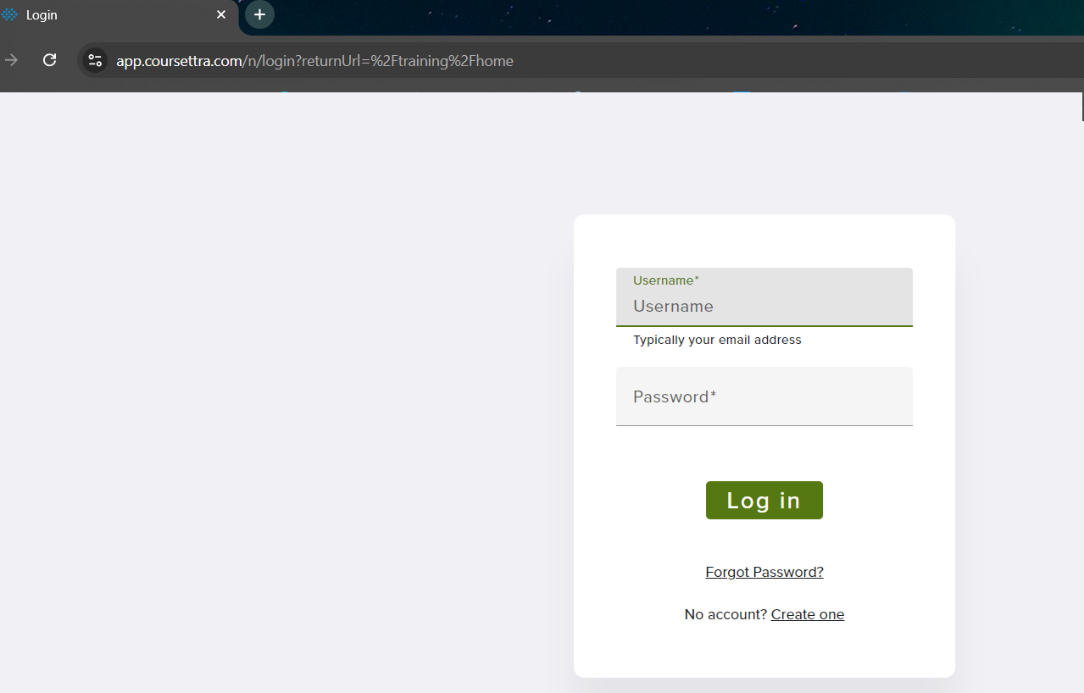
Go to this link:
https://app.coursettra.com/portal/login
2) Click “Create one” to create a new account. This login is separate from the Web Portal login, so a new one will need to be created.

Slide 3
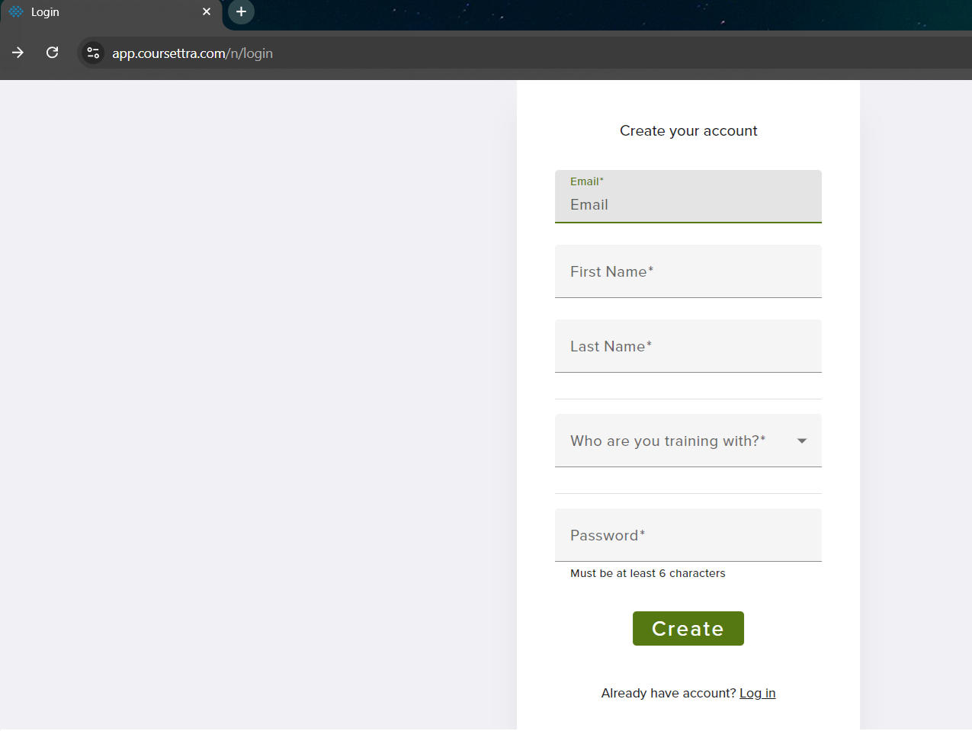
3) Enter the required info:
Enter your email address, this will become your username
Enter your first name
Enter your last name
In the “Who are you training with?” field, select Ontario One Call from the pull-down menu
Enter your organization from the pull-down menu that will appear
Create a password (6 characters, 1 uppercase, 1 lowercase, 1 number, and 1 special character)
Click “Create”

Slide 4
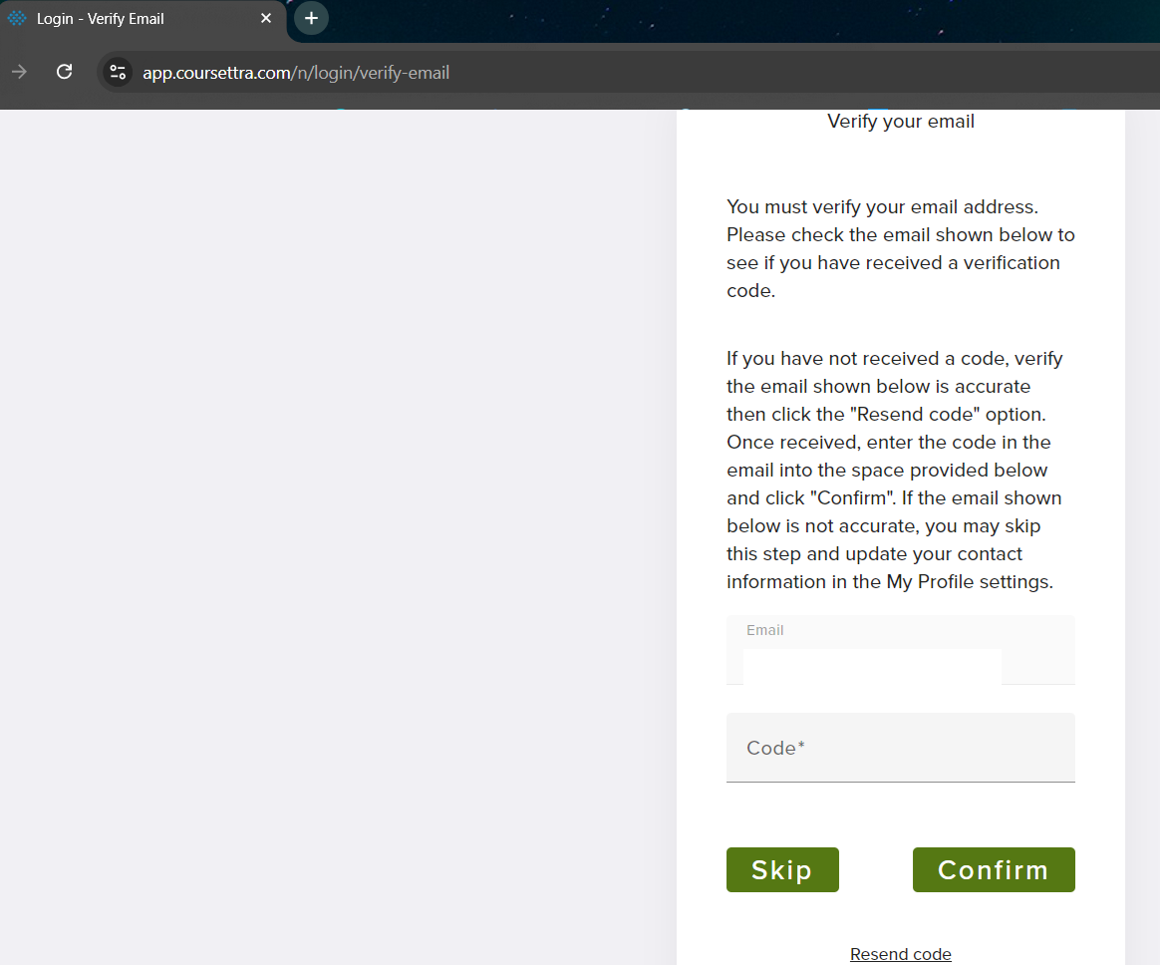
4) Use this screen to verify your email address.
Verifying your email will allow you to reset your password by yourself

Slide 5
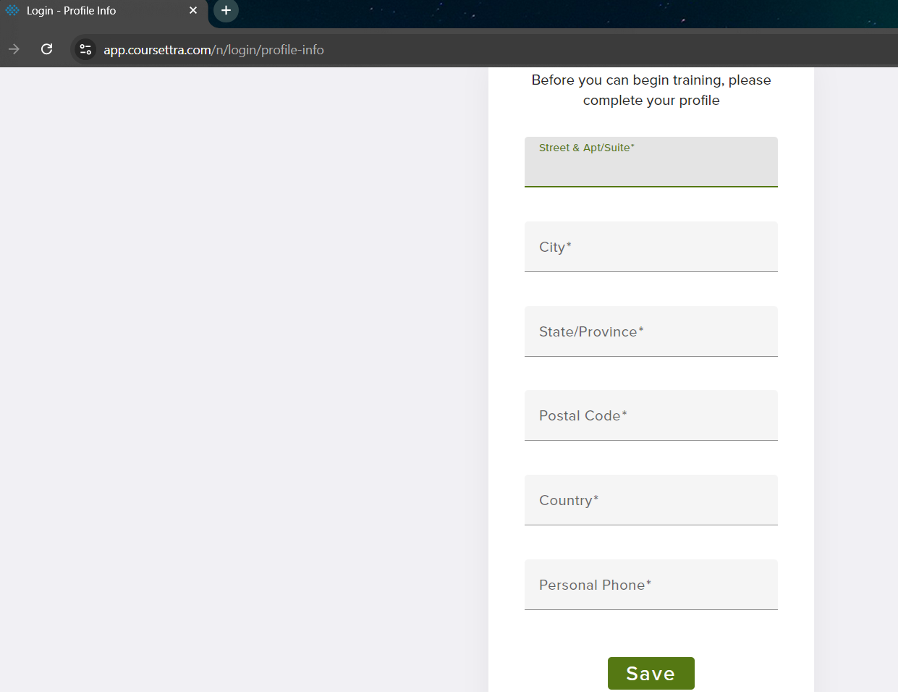
5) Complete your profile by adding the following:
Enter your street address
Add your City
Add ON as your Province
Add your postal code
Add CAN as your Country, if it doesn’t autofill
Enter your phone number
Press “Save”

Slide 6
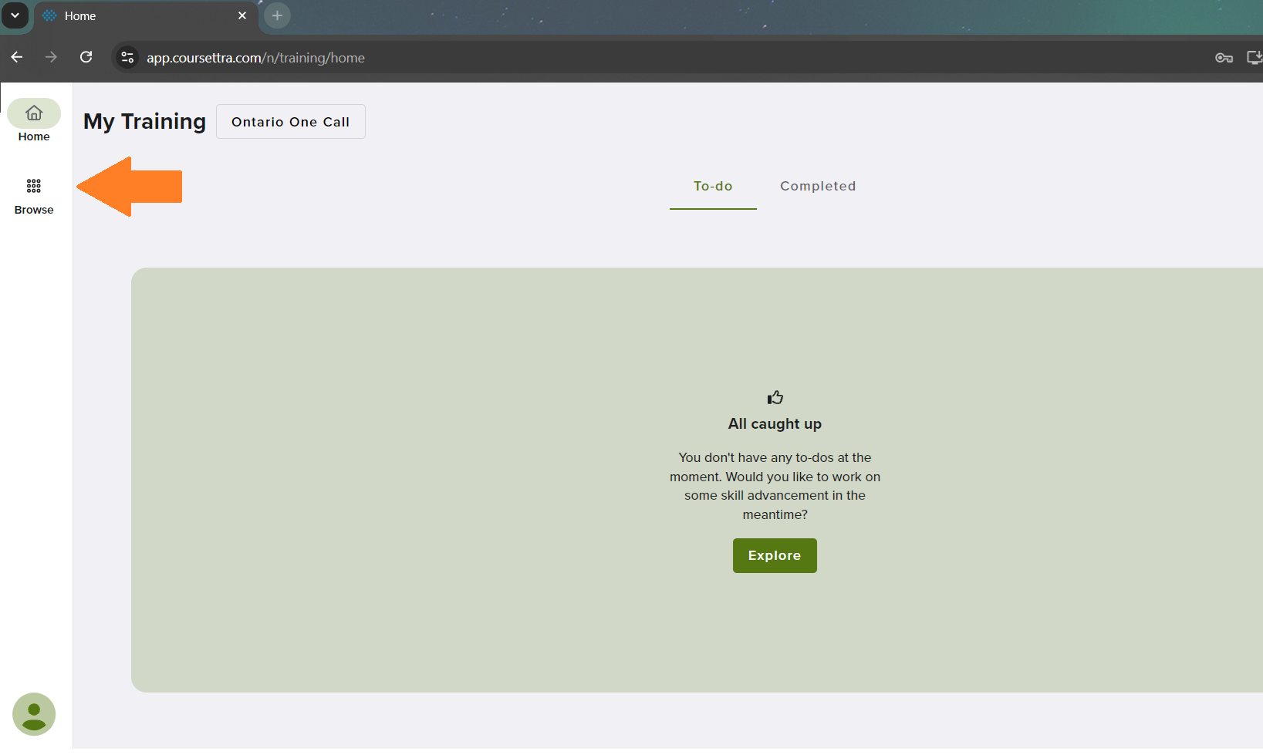
6) Once logged in your screen will look like this.
Click “Browse” in the side bar

Slide 7
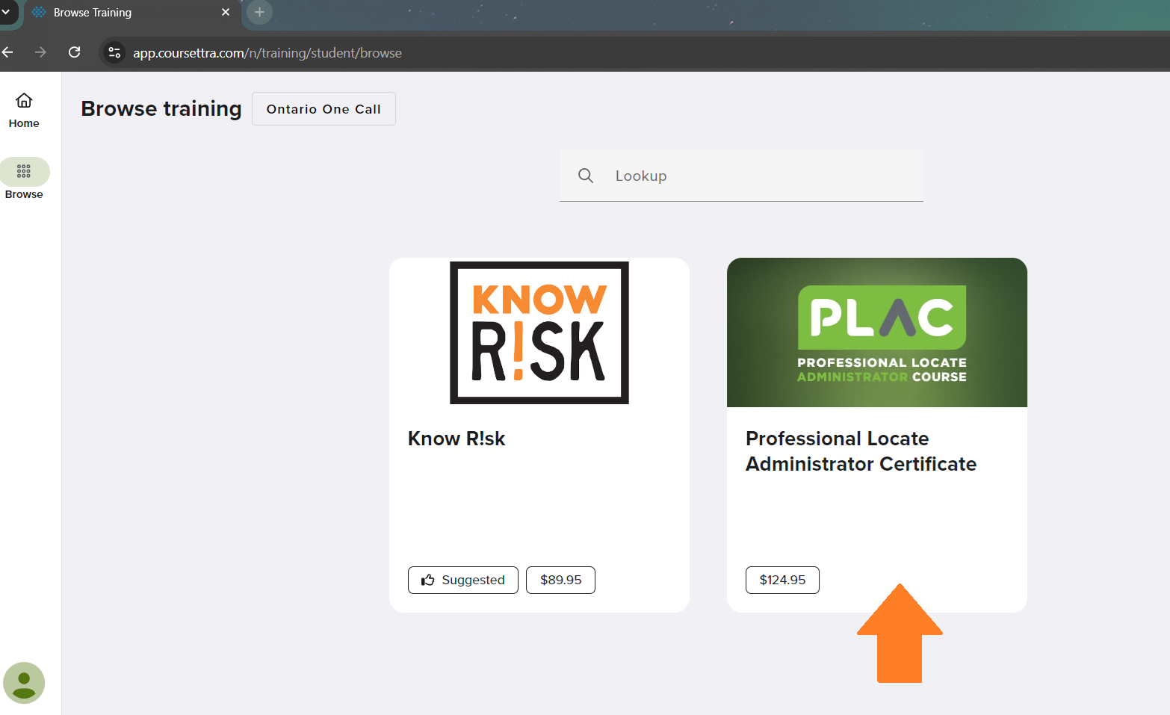
7) Your screen will now look like this.
Click “Professional Locate Administrator Certificate”

Slide 8
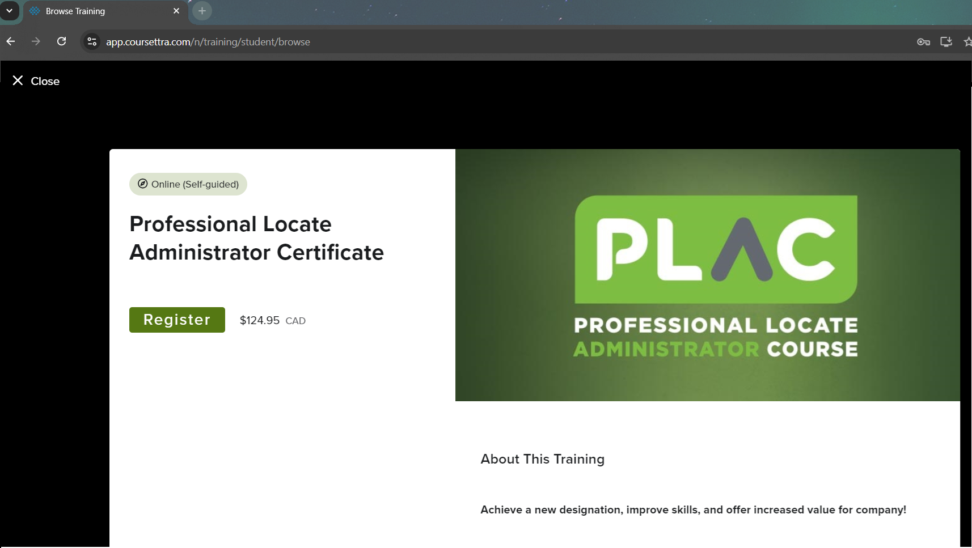
8) Your screen will now look like this.
Click “Register”

Slide 9
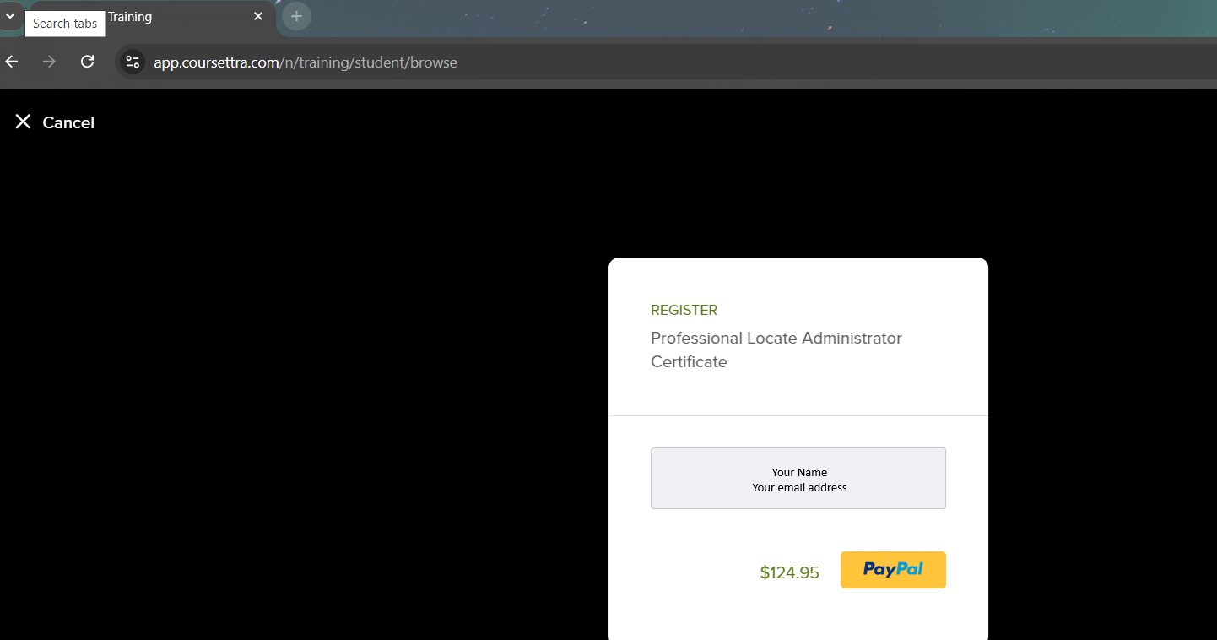
8) Your screen will now look like this.
Click PayPal
Pay through PayPal.
If this is not an option for you, please contact Training@OntarioOneCall.ca and we will arrange other payment

Slide 10
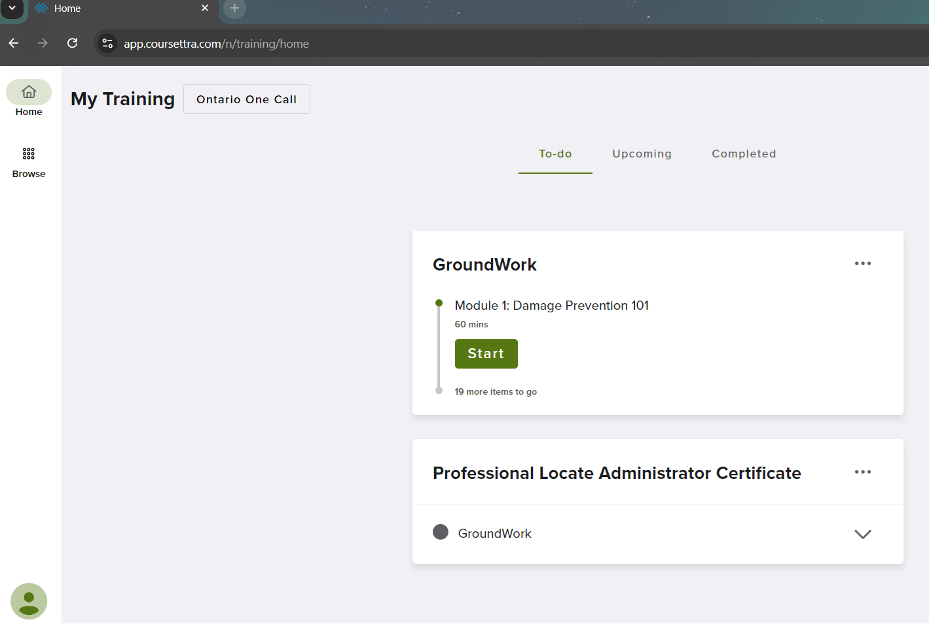
9) Congratulations! You’re all registered.
Your screen should now look like this.
If you don’t see this, click the “To-do” tab at the top of the screen
Click “Start” to begin GroundWork and you’re set to become a Certified Professional Locate Administrator.

Slide 11
Training@OntarioOneCall.ca

